Slide 1
Blood transfusion
By
م.د. اسيل محمود جواد
اختصاصية الجراحة العامة
عضو الكلية الملكية البريطانية للجراحين
M.B.Ch.B MRCS FICMS

Slide 2
What is transfusion
It is Intravenous administration of blood and blood products

Slide 3
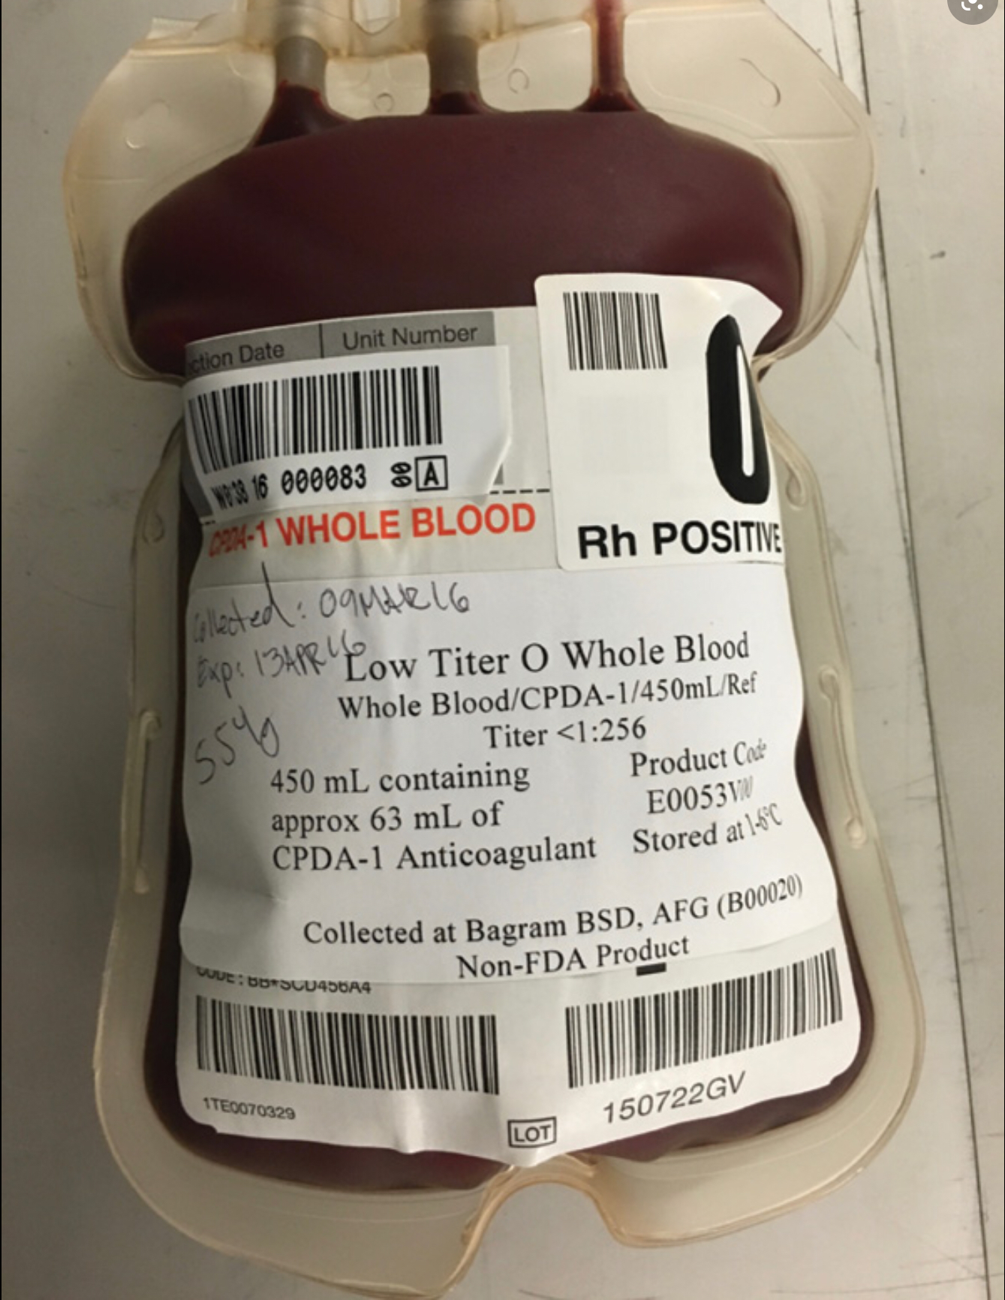

Slide 5
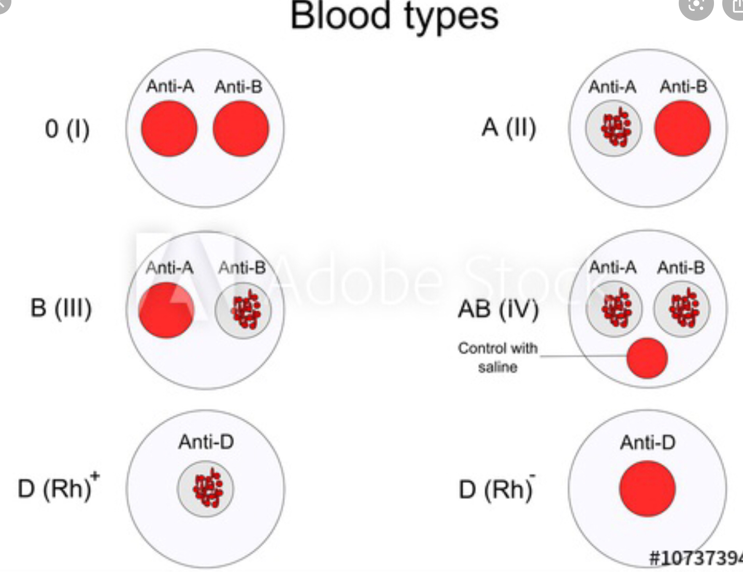
Blood groups and cross-matching
Human red cells have on their cell surface many different anti- gens.
Two groups of antigens are of major importance in surgical practice –
the ABO and rhesus systems

Slide 6
To prevent transfusion reactions, all transfusions are preceded by ABO
and rhesus typing of both donor and recipient blood to ensure
compatibility. The recipient’s serum is then mixed with the donor’s cells
to confirm ABO compatibility and to test for rhesus and any other
blood group antigen–antibody reaction.
This is called coomb’s test

Slide 7
Full cross-matching of blood may take up to 45 minutes in most laboratories.
In more urgent situations, ‘type specific’ blood is provided which is only ABO/rhesus matched and can be issued within 10–15 minutes.

Slide 8
Each unit is tested for evidence of hepatitis B, hepatitis C, HIV-1, HIV-
2 and syphilis. Donations are leukodepleted as a precaution against
variant Creutzfeldt–Jakob disease .
The ABO and rhesus D blood group is determined, as well as the
presence of irregular red cell antibodies. The blood is then processed
into subcomponents.

Slide 9
So if in emergency situations and you do not have time to cross match blood what do you suggest ?
?

Slide 10
Where blood must be given emergently, group O (universal donor)
blood is given (O− to females, O+ to males).

Slide 11
Blood products
Whole blood
Packed red cellsFresh frozen plasm FFP
Platelets
Cryoprecipetate
Prothrombin complex concentrates
Leukocyte- depleted blood
Buffy coat depleted blood
Autologous blood

Slide 13
Whole blood
Once was the gold standard, is rarely available in Western countries
Volume : 450 ml
Storage 4c ‘
Shelf life 35-42 days
Increase inflammatory response and incidence of organ failure
Main advantage is being rich with clotting factors

Slide 14
Packed RBC
Red blood cells are the product of choice for most clinical situations requiring resuscitation.
Concentrated suspensions of red blood cells can be prepared by removing most of the supernatant plasma after centrifugation.
Volume 330 ml
Storage 5 week at (2-6) C’
Better oxygen carrying capacity bec ATP level maintained

Slide 15
Leukocyte-Reduced and Washed Red Blood Cells
These products are prepared by filtration that removes about 99.9% of the white blood cells and most of the platelets (leukocyte-reduced red blood cells) and, if necessary, by additional saline washing (leukocyte-reduced/washed red blood cells).
Leukocyte reduction prevents almost all febrile non hemolytic transfusion reactions (fever and/or rigors), alloimmunization to HLA class I antigens, and platelet transfusion refractoriness and cytomegalovirus CMV transmission.

Slide 16
Platelet Concentrates
The indications for platelet transfusion include, thrombocytopenia
caused by inadequate production, and qualitative platelet disorders.
The shelf life of platelets is 120 hours from time of donation.
volume of approximately 50 mL

Slide 17
Fresh Frozen Plasma (FFP)
prepared from freshly donated blood is the usual source of the vitamin K-dependent factors and is the only source of factor V.
Volume 200 ml
Storage -30c’
Shelf life

Slide 18
Prothrombin complex (PCC)
are highly purified concentrates prepared from pooled plasma.
They contain factors II, IX and X. Factor VII may be included separately.
Indicated for the emergency reversal of anticoagulant(warfarin) therapy in uncontrolled hg.

Slide 19
Cryoprecipetate
20 ml
Storage -30c’
Contain
Given when fibrinogen <0.8 g/L

Slide 20
Autologous blood
It is possible for patients undergoing elective surgery to pre- donate their own blood up to 3 weeks before surgery for retransfusion during the operation. Similarly, during surgery blood can be collected in a cell-saver which washes and collects red blood cells which can then be returned to the patient.

Slide 21
Indications for blood transfusion
BT should be avoided if possible, The indications for blood transfusion are as follows:
acute blood loss, to replace circulating volume and maintain oxygen delivery;
perioperative anaemia, to ensure adequate oxygen delivery cut value of Hb 6 g/dl is acceptable in patients who are not actively bleeding, not about to undergo major surgery and are not symptomatic.
symptomatic chronic anaemia, without hg or impending surgery.

Slide 22
Complications of blood transfusion
incompatibility haemolytic transfusion reaction
febrile transfusion reaction
allergic reaction
infection– bacterial infection – hepatitis– HIV– malaria
air embolism
Thrombophlebitis
transfusion-related acute lung injury (usually from FFP).

Slide 23
Complications from massive transfusion
coagulopathy
hypocalcaemia
hyperkalaemia
hypokalaemia
hypothermia.
Iron overload.

Slide 24
Incompatibility haemolytic transfusion reaction
Error in cross matches or clerk error
IgM against A or B antigen
Fever ,rash , red urine ,flank pain, haematuria ,pain at cannula site ,tachycardia,hypotension
IMMEDIATELY stop transfusion
Draw blood for recross match
Start fluid resuscitation to prevent kidney injury
Give adrenaline sc, or iv

Slide 25
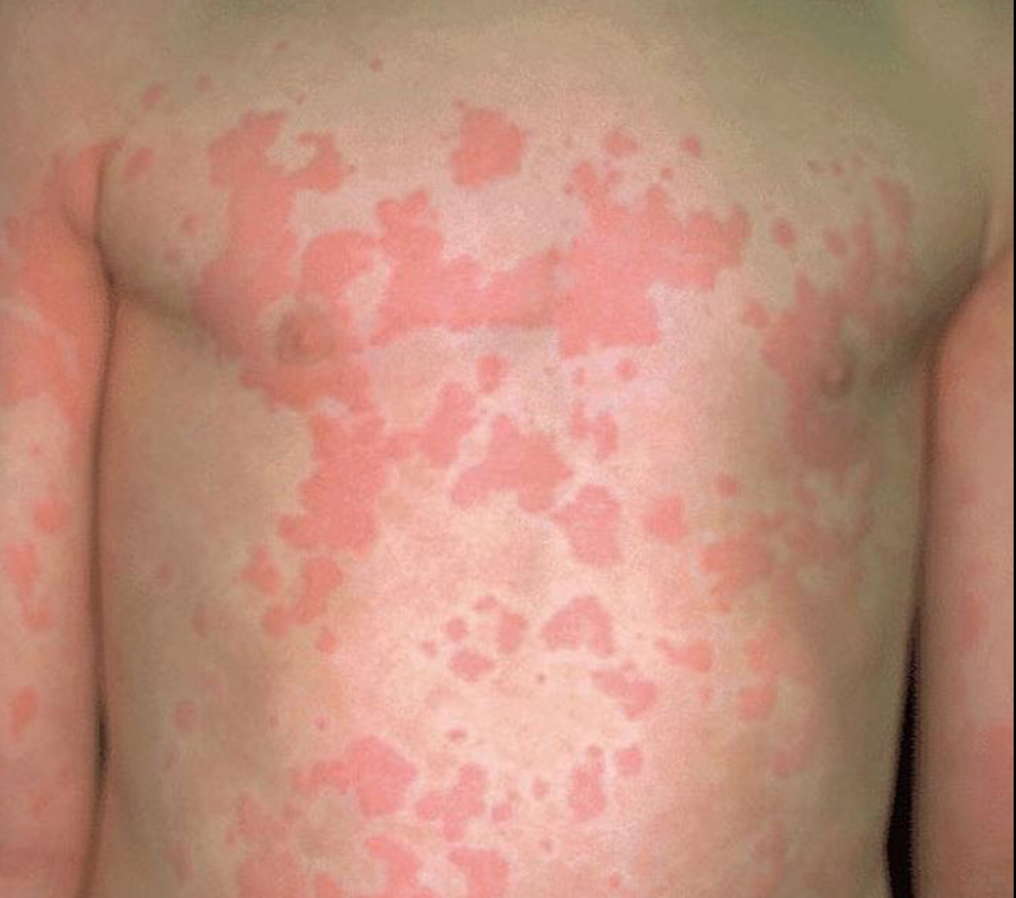

Slide 26
Non haemolytic (febrile) reaction
Antibodies to leukocyte causing destruction of the wbc and release of pyrogens causing chills and fever
Stop transiently or slow down the transfusion rate
Give paracetamol
Cold sponge
Prevention: leukocyte –depleted / washed

Slide 27
Thank you

